Slide 1
Welcome to my presentation

Slide 2
ABOUT ME :
NAME : SIRAPARAPU YAMINI
CLASS : D.EL.ED (1st YEAR)
ROLL NO : 47
MEDIUM : ENGLISH

Slide 3
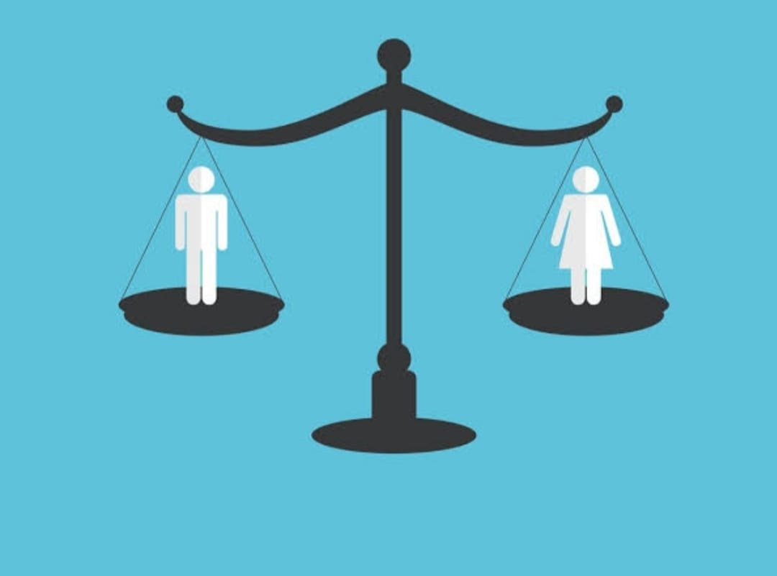
TOPIC NAME
THE STATUS OF GENDER
EQUALITY IN
EDUCATION SECTOR

Slide 4
What is a gender?
Gender refers to the characteristics of women, men, girls and boys that are socially constructed.

Slide 5

What is gender bias?
Gender bias is a favoritism toward one gender over another.

Slide 6

GENDER EQUALITY
Gender equality is achieved when women
and men, girls and boys , have equal rights
,life prospects and opportunities, and the
power to shape their own lives and
contribute to society

Slide 7

Importance of gender equality
Gender equality prevents violence against women and girls. it’s essential for economic prosperity. Socities the value women and men as equal are safer and healthier . Gender equality is a human right

Slide 8

How does gender equality affect education?
There is a little doubt that education has a major effect on economic growth …Gender inequality in education likely affects education indirectly, through different channels such as by lowering the fertility rate, increasing the life span of the population , and increasing social cohension.

Slide 9
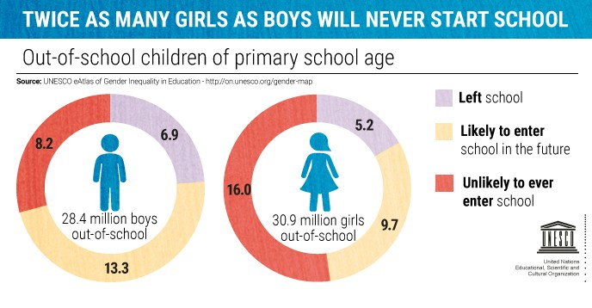
This Photo by Unknown Author is licensed under CC BY-NC-ND

Slide 10
Causes of gender inequality in school education
Gender based inequlities in education around the world, according to UNESCO are mainly determined by
1)poverty
2)geographical solution
3)minority status
4)early marriage and pregency
5)gender based violence
6)illetracy

Slide 11
Gender equality is a
human fight , not a
female fight

Slide 12

This Photo by Unknown Author is licensed under CC BY

